Slide 1
Cybersecurity of Discrete Control Systems
Mengxiang Jiang

Slide 2
AGENDA
Introduction
Architecture and Logic
System Characteristics and Algorithms
Results and Conclusion

Slide 3
INTRODUCTION
“Reports that say that something hasn't happened are always interesting to me, because as we know, there are known knowns; there are things we know we know. We also know there are known unknowns; that is to say we know there are some things we do not know. But there are also unknown unknowns—the ones we don't know we don't know. And if one looks throughout the history of our country and other free countries, it is the latter category that tends to be the difficult ones.” – Donald Rumsfeld

Slide 4
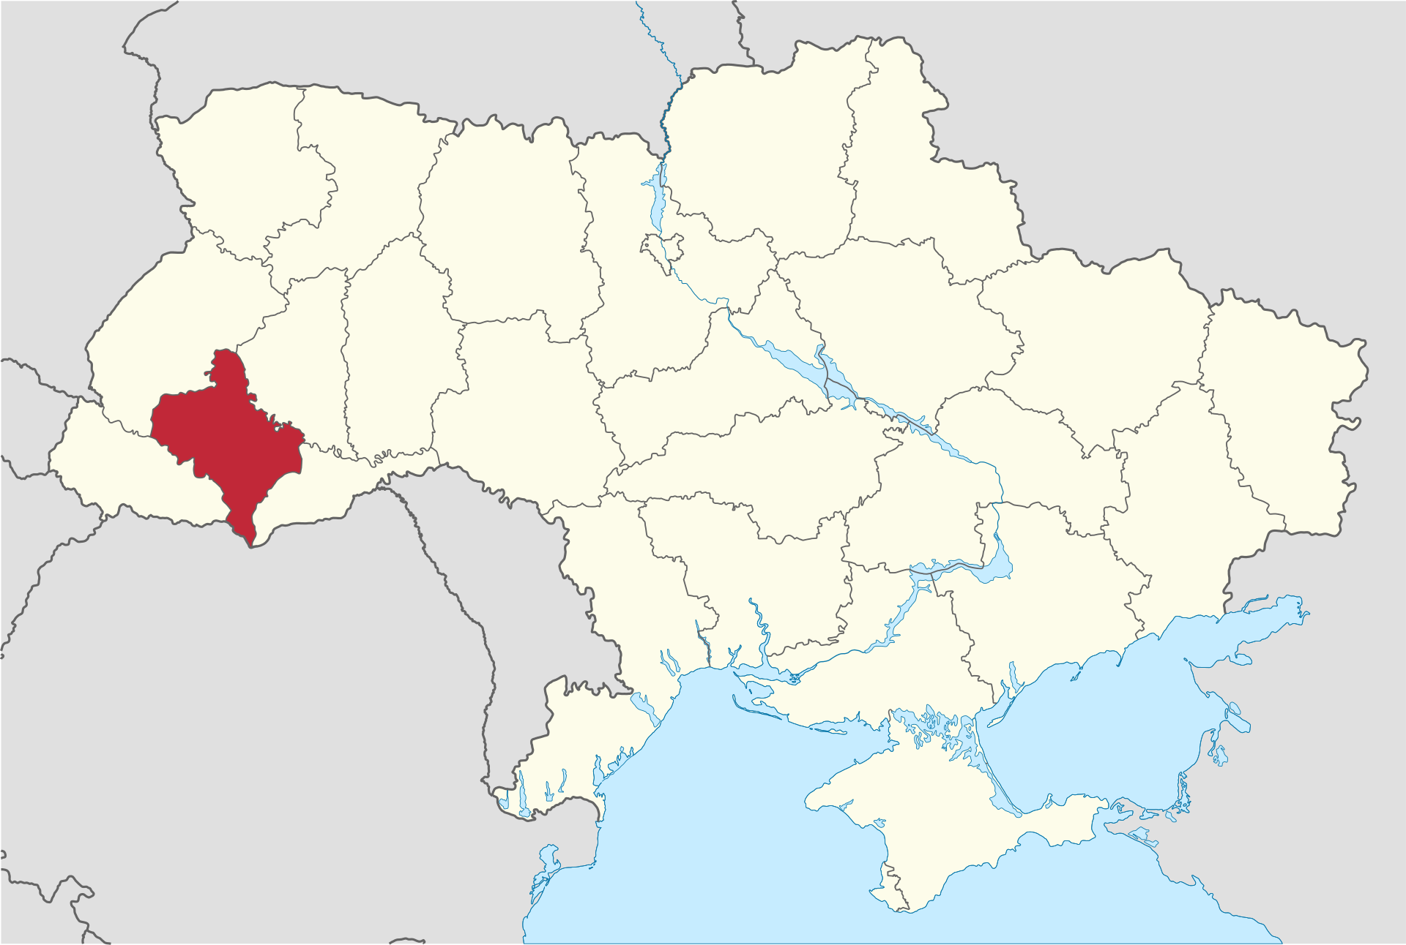
Ukraine Power Grid Hack
On December 23, 2015, three Ukrainian power distribution companies were hit by a well-orchestrated false data injection (FDIA) cyber-attack, causing power outages for about 225,000 customers for several hours.
The attackers employed a multifaceted strategy that included using BlackEnergy 3 malware, spear phishing emails, a telephonic denial-of-service attack, and a modified KillDisk firmware attack.
These methods compromised security, enabling them to take over the Supervisory Control and Data Acquisition (SCADA) network and target field devices, facilitating remote disruption of substation breakers.
Manual intervention was eventually needed to restore power and rectify the situation.
Image source: commons.wikimedia.org/wiki/File:Ivano-Frankivsk_in_Ukraine.svg

Slide 5
Why the Attack was Successful
“strongest capability of the [Ukraine blackout] attackers was […] their capability to perform long-term reconnaissance operations required to learn the environment and execute a highly synchronized, multistage, multisite attack” – SANS (Escal Institute of Advanced Technologies)
The Internet grants the attackers extensive access to power system information and vendor specifics(textbooks, research publications, industry standards, etc.), equipping them with a substantial knowledge base to strategically plan and execute cyber-attacks.
Unsecure firewalls, network protocols, encryption, and VPN connections allowed attackers in.

Slide 6
Architecture
Solution proposed in “Learning behavior of distribution system discrete control devices for cyber-physical security” by Roberts et al. (all figures and equations from here on comes from this)
Utilize Phasor Measurement Units (PMU) as an independent isolated read-only sensor network focused on monitoring SCADA traffic
Specifically the On-Load Tap Changing (OLTC) transformers and capacitor banks
Additionally tries to detect attackers during the reconnaissance stage
Uses a set of algorithms to passively learn and monitor the control logic

Slide 7
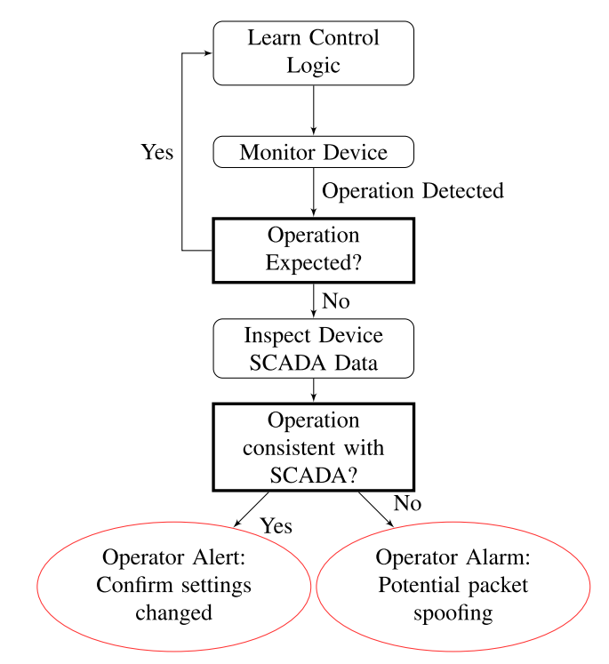
Detection Logic

Slide 8
Why learn behavior?
In principle, the behavior of each component on the grid should be known to the operators, so is this redundant?
No, learning the behavior from the measurements makes the architecture read-only, isolating the data from outdated and potentially incorrect data entry and manipulation.

Slide 9
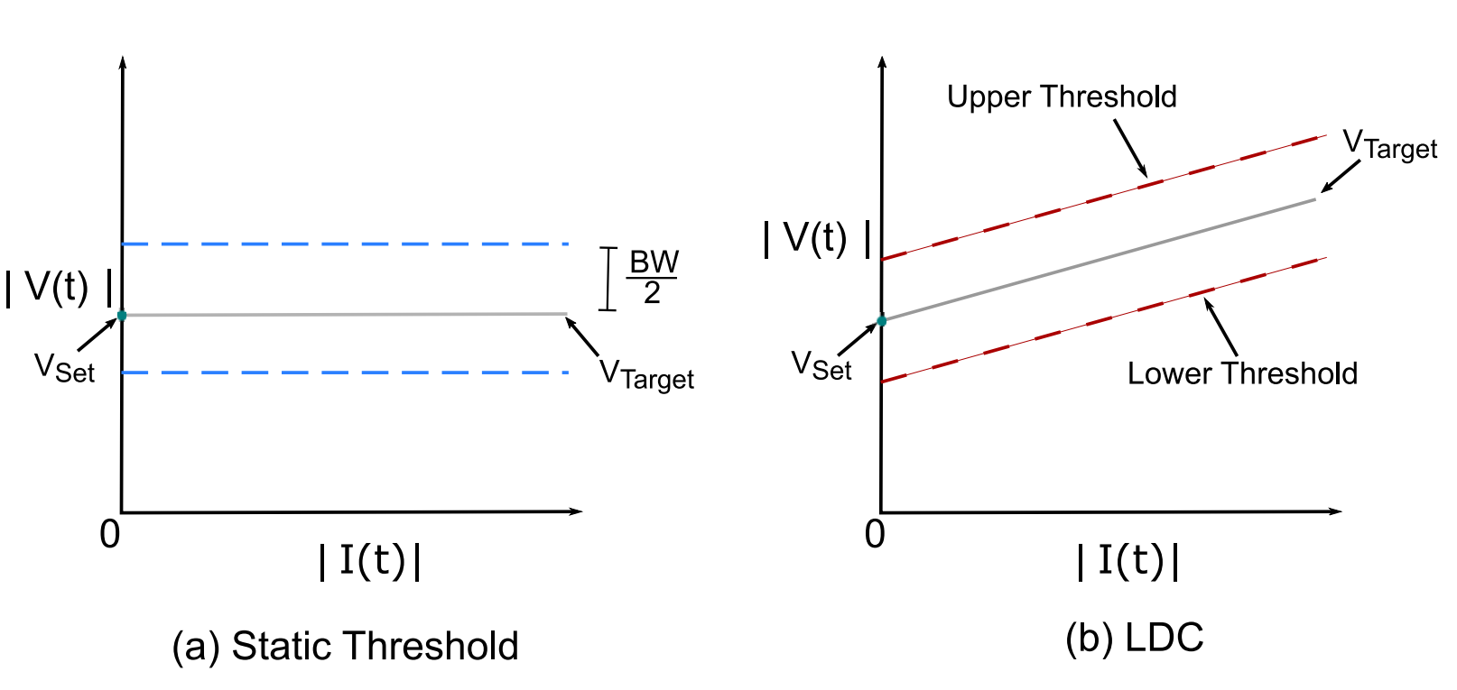
Transformers/Voltage Regulators
Voltage regulation can be static or perform Line Drop Compensation (LDC), where the difference between customer voltage and regulator voltage is due to a voltage drop along lines and other transformers

Slide 10
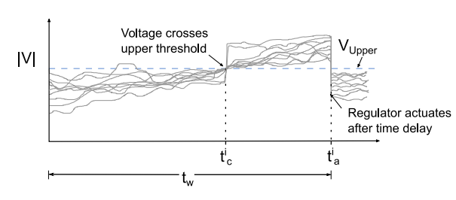
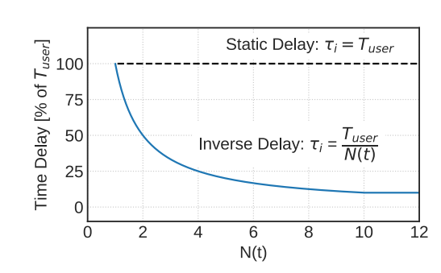
Regulator Time Delay
When a regulator detects a voltage exceeding the permissible range, it initiates a countdown before taking corrective action. If the voltage returns to the acceptable range before the timer ends, it resets and no action is taken; otherwise, it performs a tap change operation to restore voltage.

Slide 11





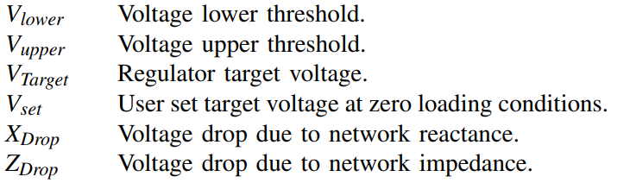
Voltage Regulation Equations

Slide 12
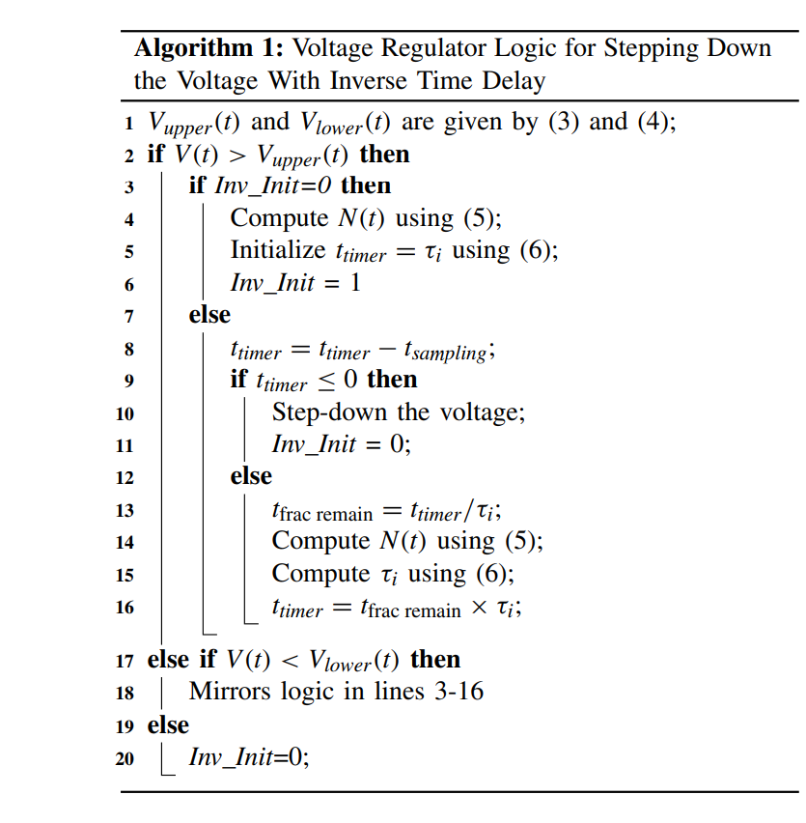
Voltage Regulator Algorithm

Slide 13
Switched Capacitor Banks
The behavior is similar to a voltage regulator, with upper and lower thresholds and associated time delay
However, there is an additional safety switching delay that allows the operators to move away from the capacitor bank, given that the potential for fault is higher during a switching action
The capacitor bank will perform a switching action once the safety switching delay countdown timer is initiated, regardless of whether the voltage returns to within the thresholds, unless a physical button is pressed for manual override

Slide 14
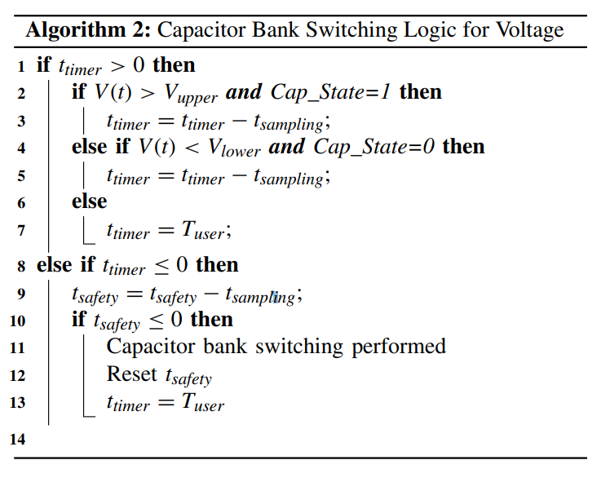
Capacitor Bank Algorithm

Slide 15
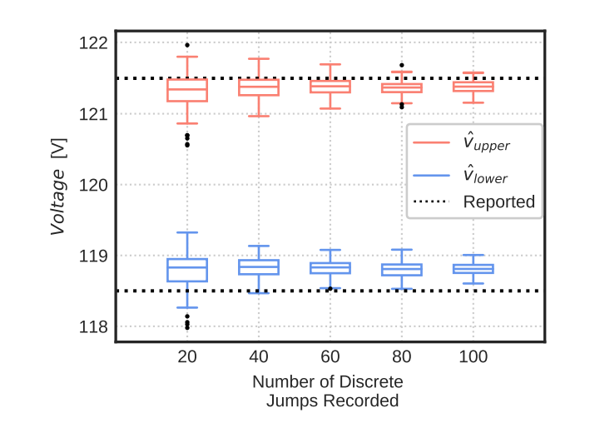
Results
The researchers simulated three different control schemes:
OLTC with static thresholds and a fixed time delay
OLTC with LDC-Z and a fixed time delay
OLTC with LDC-R&X and an inverse time delay
However, they mainly focused on OLTC 2 in their results

Slide 16
Conclusion
The results support the intuition that with more events, the range of estimates decrease, allowing greater confidence as the historical events accumulate
Estimation ranges seem to stabilize above 60 total events, with minimal improvement beyond 80 events
One downside is that the fewer events has noticeably weaker performance, and follow-on work might mitigate this by considering by considering the statistical properties of a family of events prior to execution of a tap change or capacitor switching logic

Slide 17
REferences
C. Roberts, A. Scaglione, M. Jamei, R. Gentz, S. Peisert, E. M. Stewart, C. McParland, A. McEachern, and D. Arnold, ‘‘Learning behavior of distribution system discrete control devices for cyber-physical security,’’ IEEE Trans. Smart Grid, vol. 11, no. 1, pp. 749–761, Jan. 2020.
G. Liang, S. R. Weller, J. Zhao, F. Luo, and Z. Y. Dong, “The 2015 Ukraine blackout: Implications for false data injection attacks,” IEEE Trans. Power Syst., vol. 32, no. 4, pp. 3317–3318, Jul. 2017.
R. V. Yohanandhan, R. M. Elavarasan, P. Manoharan and L. Mihet-Popa, "Cyber-Physical Power System (CPPS): A Review on Modeling, Simulation, and Analysis With Cyber Security Applications," in IEEE Access, vol. 8, pp. 151019-151064, 2020, doi: 10.1109/ACCESS.2020.3016826.
S. Pan, T. Morris, and U. Adhikari, “Developing a hybrid intrusion detection system using data mining for power systems,” IEEE Trans. Smart Grid, vol. 6, no. 6, pp. 3104–3113, Nov. 2015.
Y. Yang et al., “Multiattribute SCADA-specific intrusion detection system for power networks,” IEEE Trans. Power Del., vol. 29, no. 3, pp. 1092–1102, Jun. 2014.

